Slide 1
BOOK BUDDY
A simple Flutter app to demonstrate CRUD operations using Back4App.

Slide 2
CONTENTS
Introduction
Architecture
Authentication
Database Structure
Software Requirements
App Screenshots
Key Challenges
Links

Slide 3
INTRODUCTION
Book Buddy is a Flutter-based application for efficient management of books data.
It utilizes Back4App for seamless data storage and retrieval of the book information.
The following book data are included in the application,
Title
Author
Genre
Availability Status
It implements CRUD (Create, Read, Update, Delete) operations on the book details.

Slide 4
ARCHITECTURE
UI Layer Frontend built using Flutter, enabling cross-platform compatibility for Android and iOS.
Signup/Login Screens
Book service screens – Book list, Add Book, Edit Book, Delete book
Parse API Layer (Back4App Integration) The app uses ParseUser API [signUp(), login()] to communicate with Back4App.
Backend Powered by Back4App (Parse Server), which handles user authentication, data storage, and session validation.

Slide 5
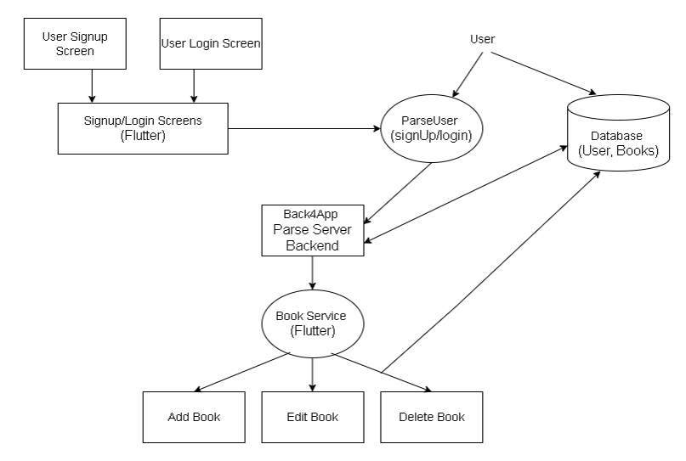

Slide 6
AUTHENTICATION
Signup/Login screens built using Flutter forms.
Used Back4App’s ParseUser class to handle – User registration : ParseUser.signUp() User login : ParseUser.login() Session Management : Persistent login using session tokens
Access Control – Data is protected using ACLs(Access Control Lists) so that only logged in users can access/modify book data.

Slide 7
DATABASE Structure
Collections
User – default class – manages authentication Fields : email, password
Books – custom class – stores book details for CRUD operations Fields : title, author, genre, availability

Slide 8
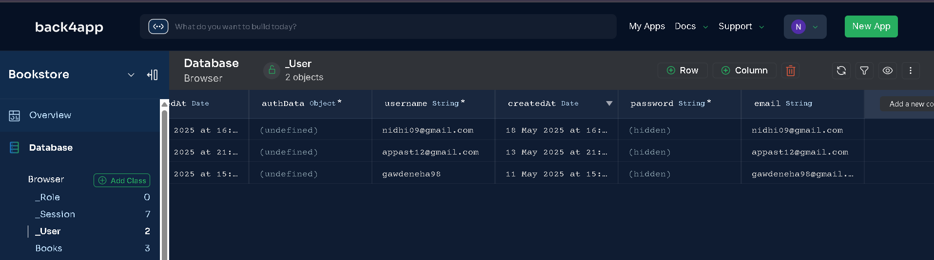
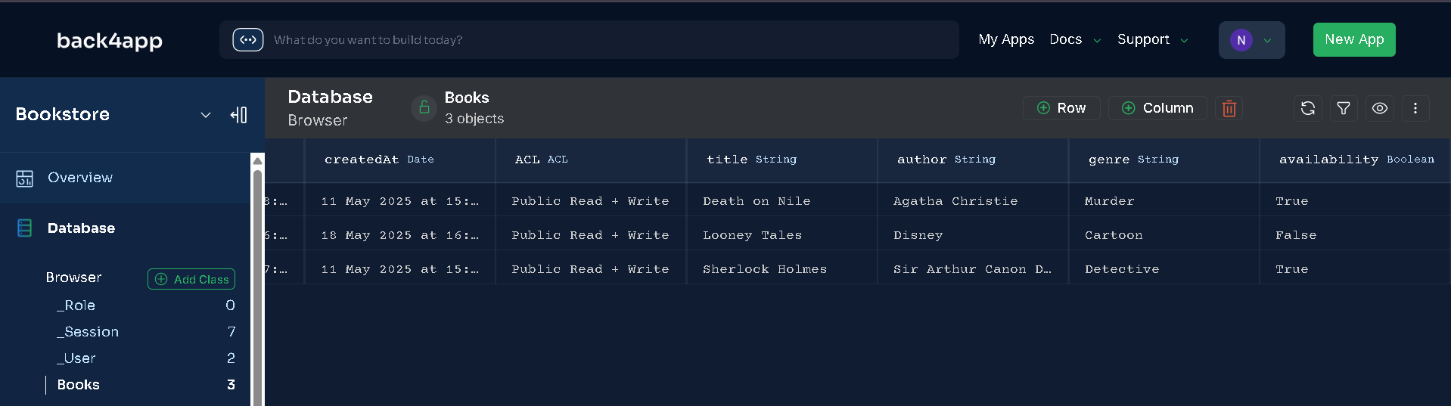

Slide 9
SOFTWARE REQUIREMENTS
Android Studio – IDE for development
Flutter SDK – for UI development
Back4App server – Backend service

Slide 10
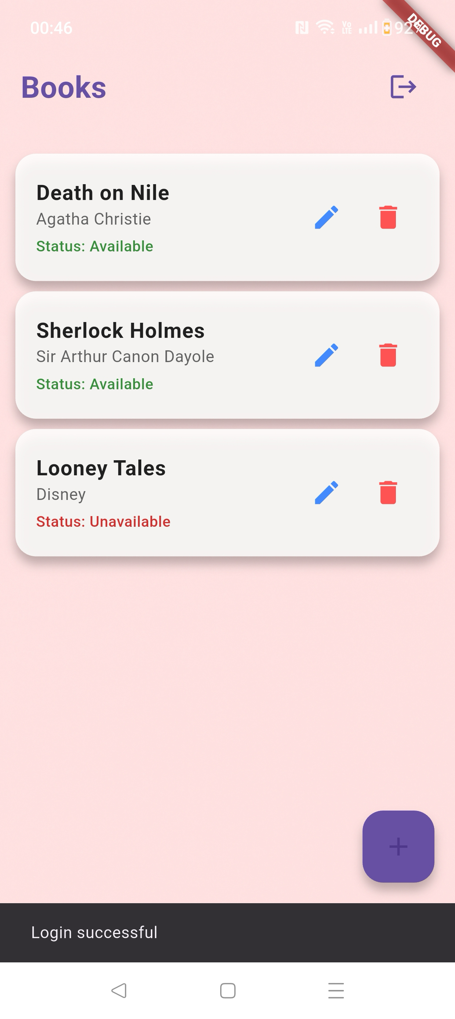
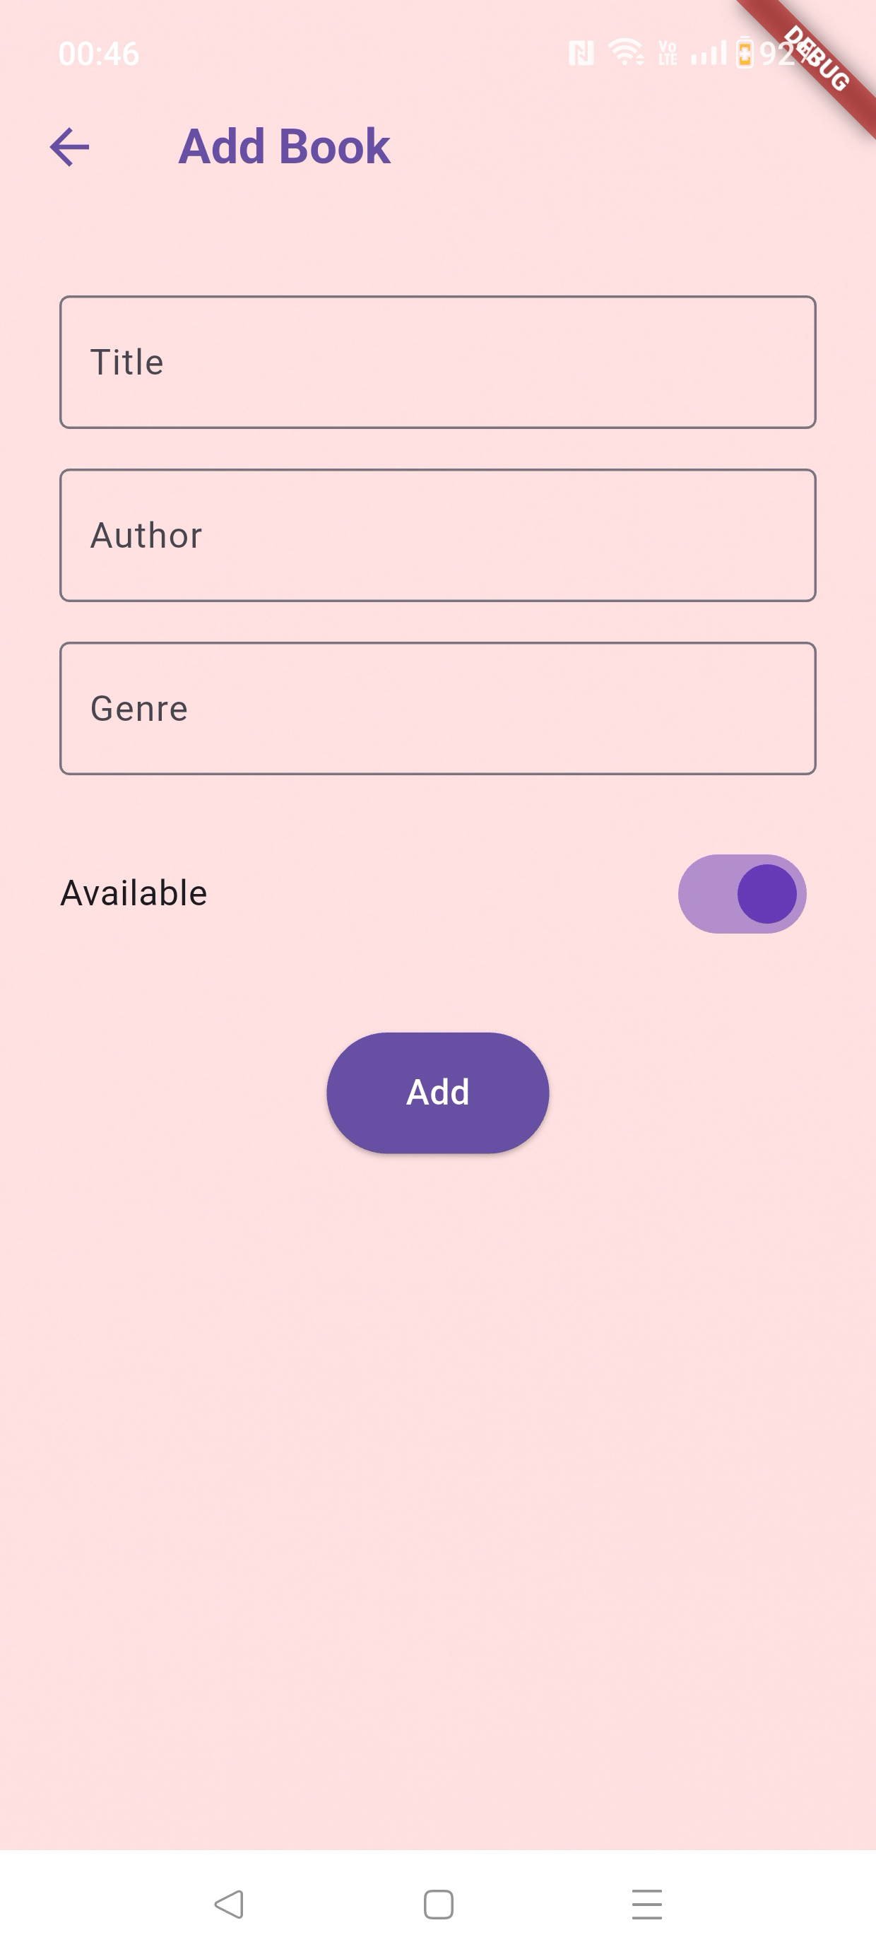
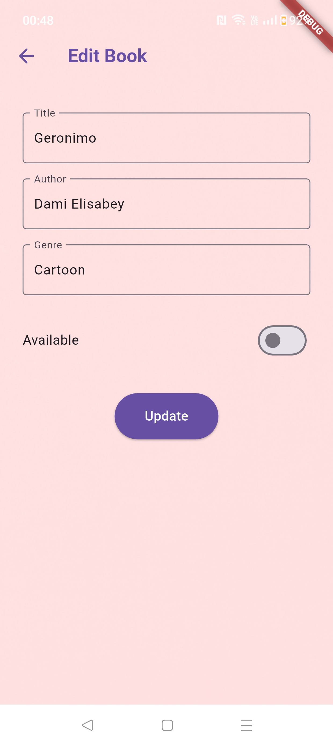
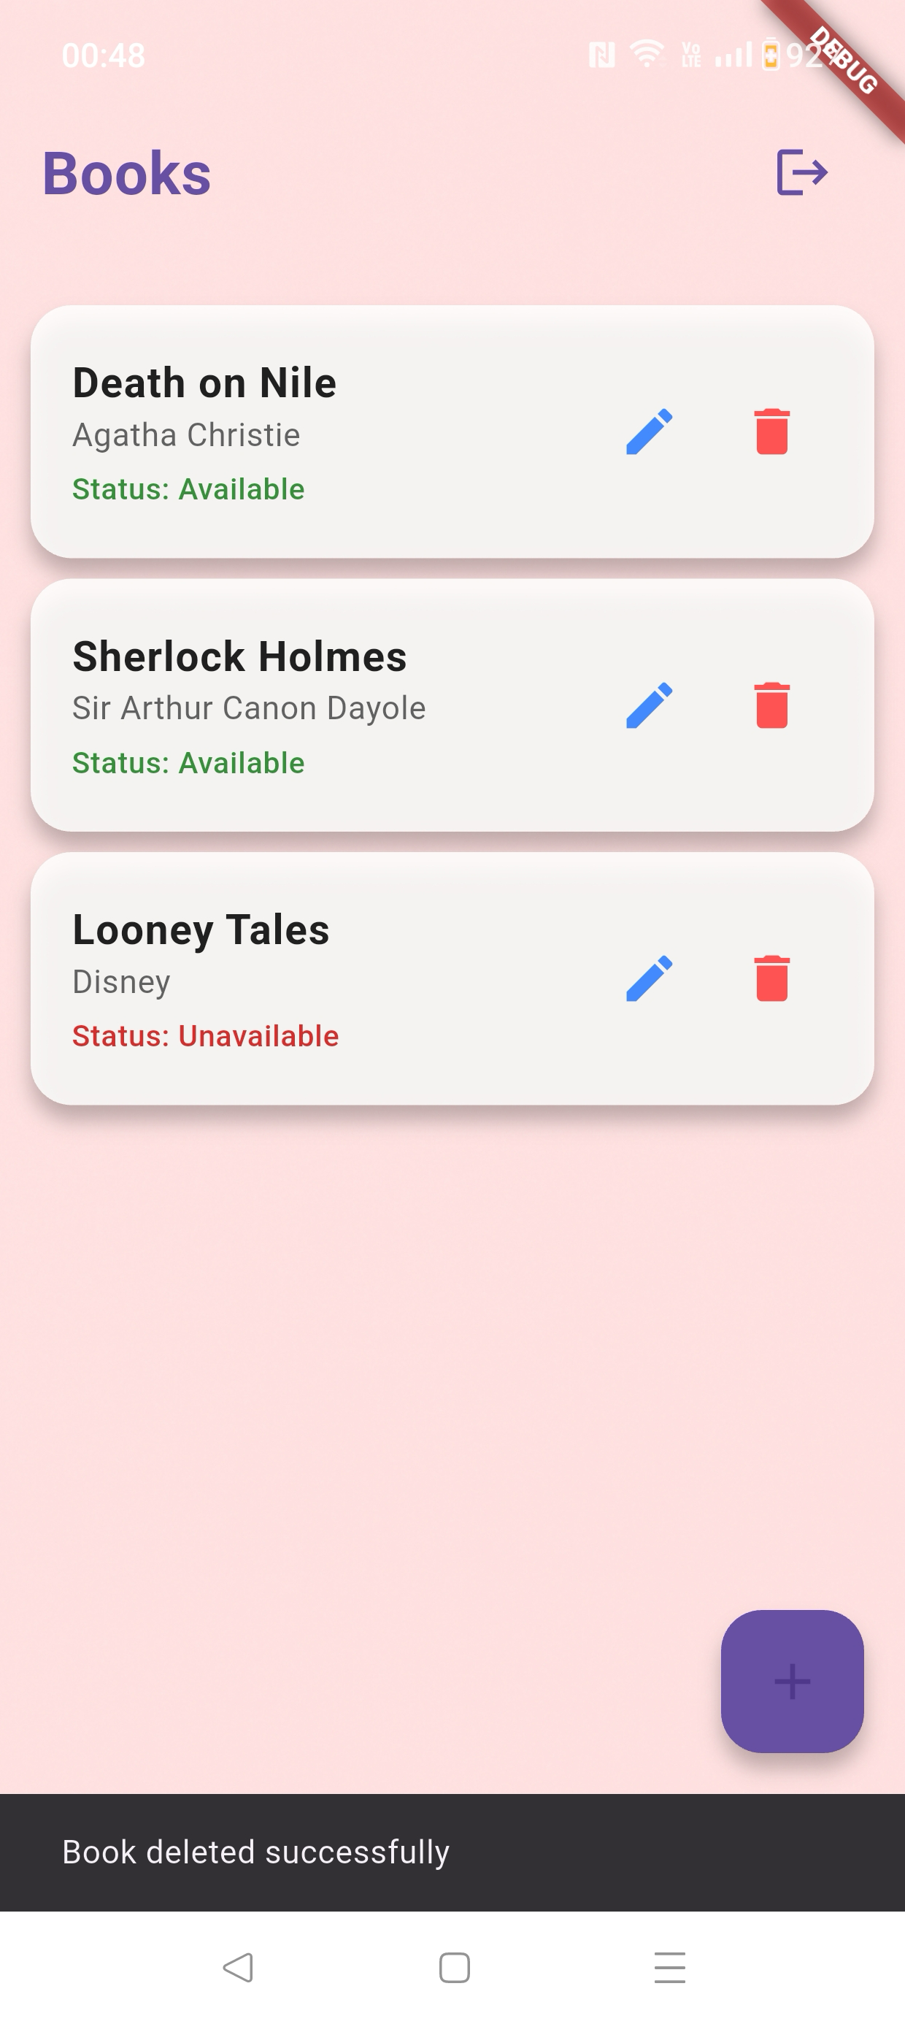
App Screenshots
List View
Create
Update
Delete

Slide 11
KEY CHALLENGES
Parse SDK version conflicts Resolved by manually updating and testing compatible package versions
Ensuring UI consistency

Slide 12
LINKS
Demo Video : https://youtu.be/1iPj51VFaTs
GitHub Repo : https://github.com/NehaGawde98/CrossPlatform_FlutterApp

Slide 13
THANK YOU
GAWDE NEHA CHANDRAKANT SHRUTI
M.Tech Software Engineering
2023TM93637@wilp.bits-pilani.ac.in

